Slide 1
冒險故事

Slide 2
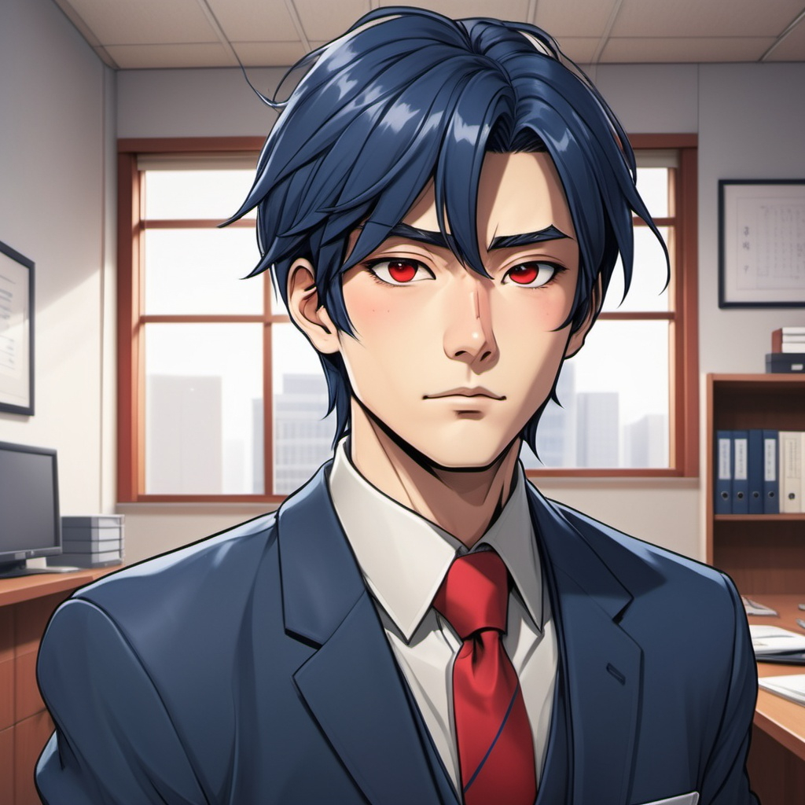
1. 目標
Notes:
The character in the illustration is a handsome, Japanese-style office worker. He has dark blue hair, wears a suit, and has a red tie. His eyes are red, and his hair features a side-swept fringe. The length of the hair extends past his eyebrows but stays above his eyes, with a neat and tidy appearance."He was pushed over due to the crowded train, and his documents scattered all over the floor."background is on the train, and documents scattered all over the floor.

Slide 3
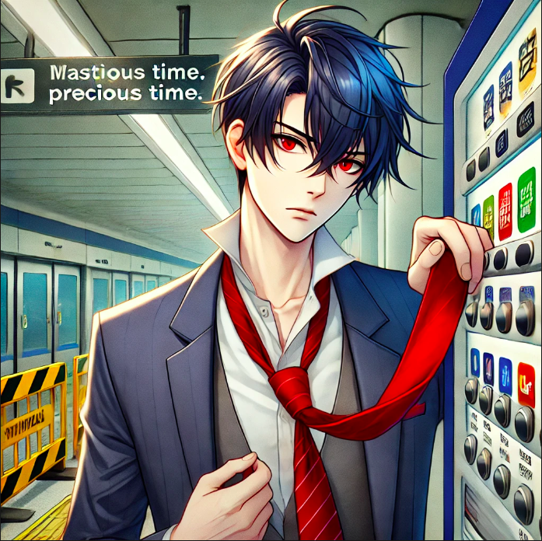
2. 阻礙
Notes:
A scene at a subway station with a handsome, Japanese-style office worker. He has dark blue hair and a side-swept fringe that extends past his eyebrows but stays above his eyes, and he has red eyes. He is wearing a suit with a striking red tie, which is caught in a vending machine, wasting precious time. The background shows the subway station with construction barriers and signage indicating temporary work. The character appears frustrated and anxious as he tries to free his tie from the machine. The scene captures the chaos of a busy commuter environment.

Slide 4
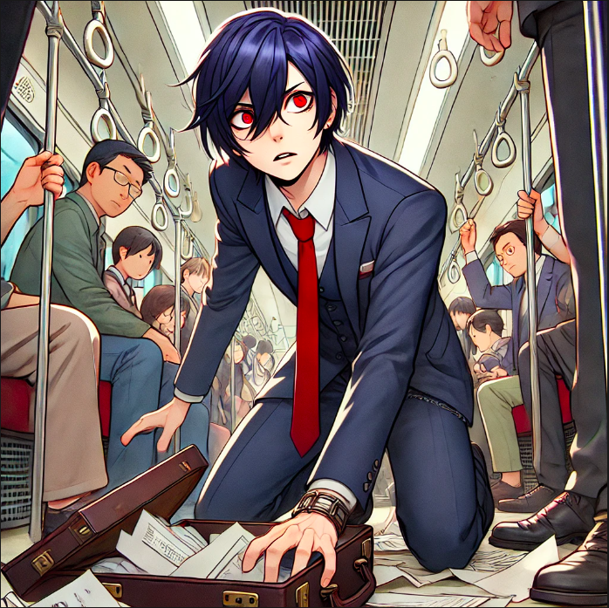
Notes:
A scene inside a crowded train, featuring a handsome, Japanese-style office worker with dark blue hair and a side-swept fringe that extends past his eyebrows but stays above his eyes, maintaining a neat appearance. He wears a business suit with a red tie and has striking red eyes. He is kneeling on the ground, trying to gather scattered documents and papers that have fallen from his open briefcase. His expression is frustrated and panicked, reflecting his anxiety about being late. Around him, passengers are packed tightly, accidentally bumping into him in the busy train. The interior includes metal poles and hanging hand straps, capturing the rush and chaos of the moment.

Slide 5
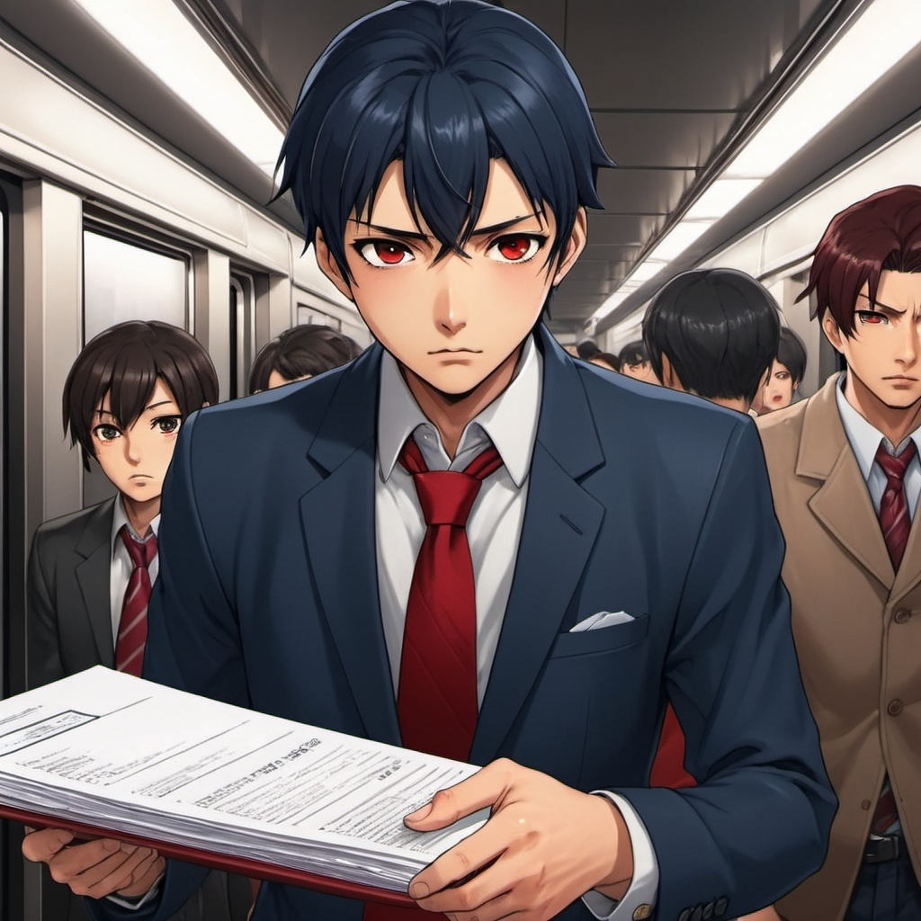
3. 努力
Notes:
The scene takes place inside a crowded subway train, focusing on two characters. The first character is a handsome, Japanese-style office worker named Tanaka Seichi. He has dark blue hair with a side-swept fringe, red eyes, and is dressed in a suit with a red tie. He appears flustered, looking down as he realizes his papers have scattered on the floor. The second character is a young man wearing headphones, casually dressed, who is bending down to pick up the documents for Seichi. The young man has a friendly demeanor, encouraging Seichi by saying, "Today is just a small challenge." The atmosphere is busy yet supportive, with other passengers watching the interaction with interest.

Slide 6
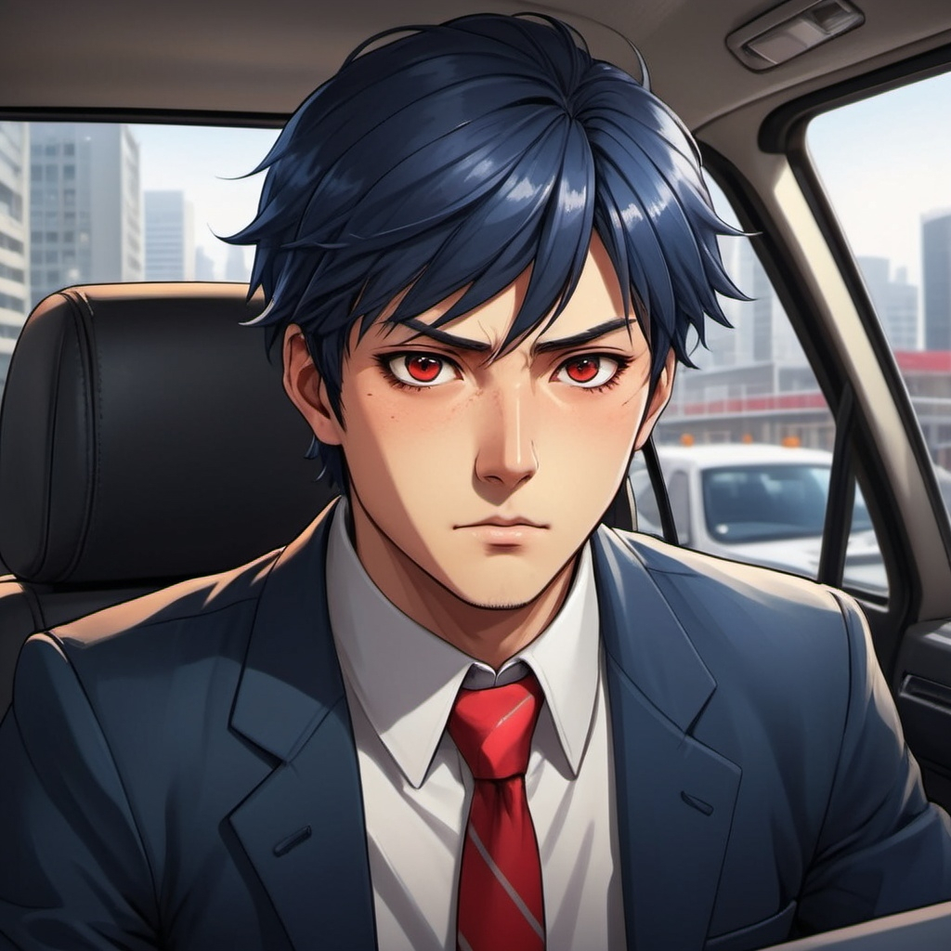
Notes:
A scene inside a taxi featuring a handsome, Japanese-style office worker. He has dark blue hair styled in a side-swept fringe that extends past his eyebrows but stays above his eyes, and his eyes are red. He is wearing a formal suit with a striking red tie. The interior of the taxi is visible, showing the driver in front and the cityscape passing by outside the window. The office worker is on his phone, looking determined and focused, as he seeks help from a colleague to modify his presentation. The atmosphere conveys a sense of urgency and purpose.

Slide 7
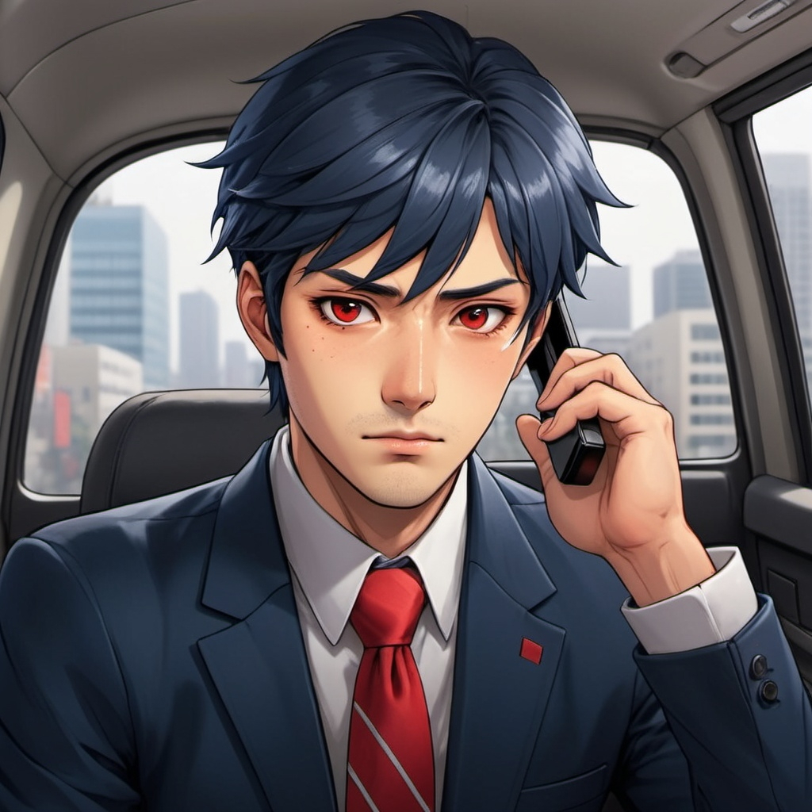
Notes:
A scene inside a taxi featuring a handsome, Japanese-style office worker. He has dark blue hair styled in a side-swept fringe that extends past his eyebrows but stays above his eyes, and his eyes are red. He is wearing a formal suit with a striking red tie. The office worker is sitting in the back seat, holding a phone to his ear, looking focused and determined as he speaks with a colleague about modifying his presentation. The interior of the taxi shows the driver in front, and the cityscape is visible through the window, capturing a sense of urgency.

Slide 8
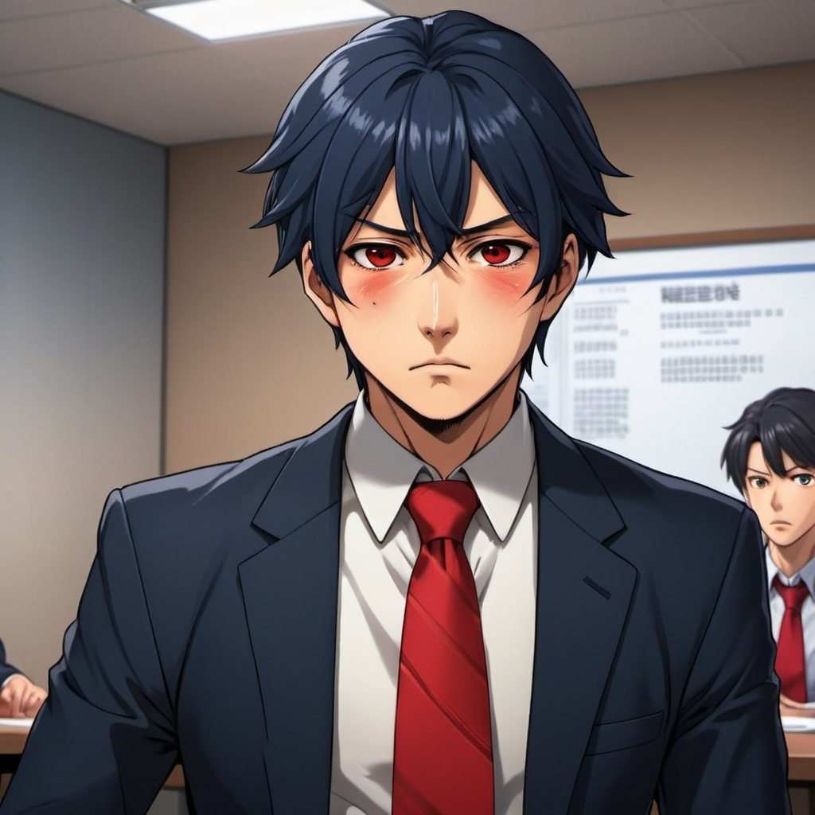
4. 結果
Notes:
The scene takes place in a conference room where Tanaka Seichi, a handsome Japanese-style office worker, stands at the front, visibly flustered and out of breath. He has dark blue hair with a side-swept fringe, red eyes, and wears a formal suit with a striking red tie. His expression conveys a mix of anxiety and determination as he clutches a presentation remote in one hand while the other rests on the table. In the background, a projector displays the last slide of his presentation, which shows a blank page, emphasizing his panic. Seichi's chest rises and falls rapidly, highlighting his labored breathing as he tries to gather his thoughts amidst the critical moment. The atmosphere in the room is tense, with colleagues watching him intently.

Slide 9
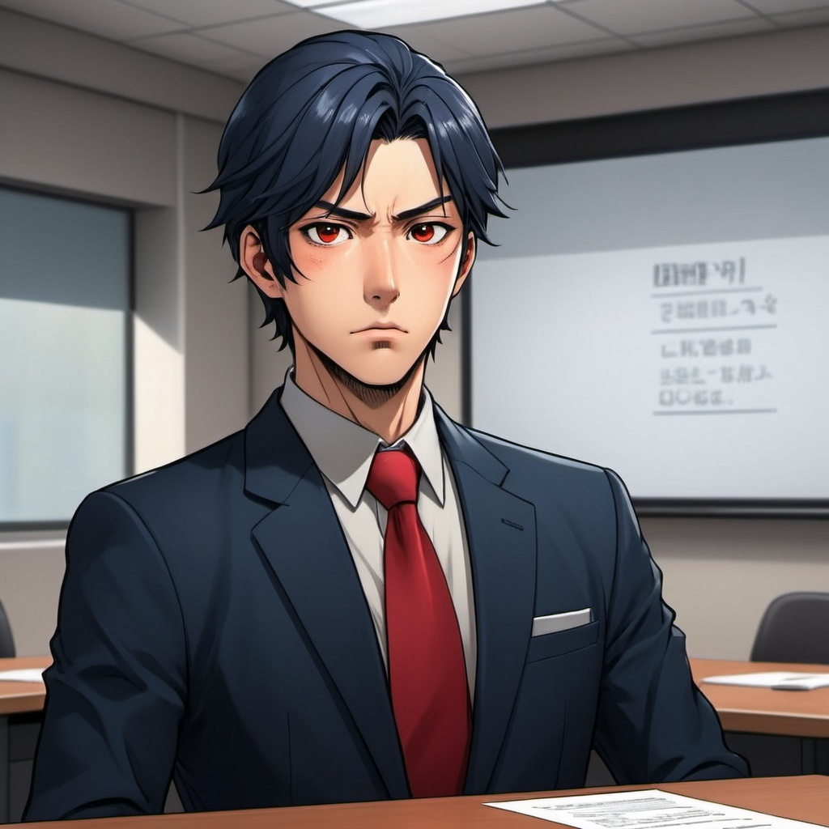
Notes:
A scene in a conference room where a handsome, Japanese-style office worker is standing at the front, looking breathless and slightly flustered as he begins his presentation. He has dark blue hair styled in a side-swept fringe that extends past his eyebrows but stays above his eyes, and his eyes are red. He is wearing a formal suit with a striking red tie. The room is filled with attentive colleagues seated at a long table, and a projector displays his slides. The character looks anxious as he realizes that he has accidentally left out part of his presentation materials, causing a blank slide.

Slide 10
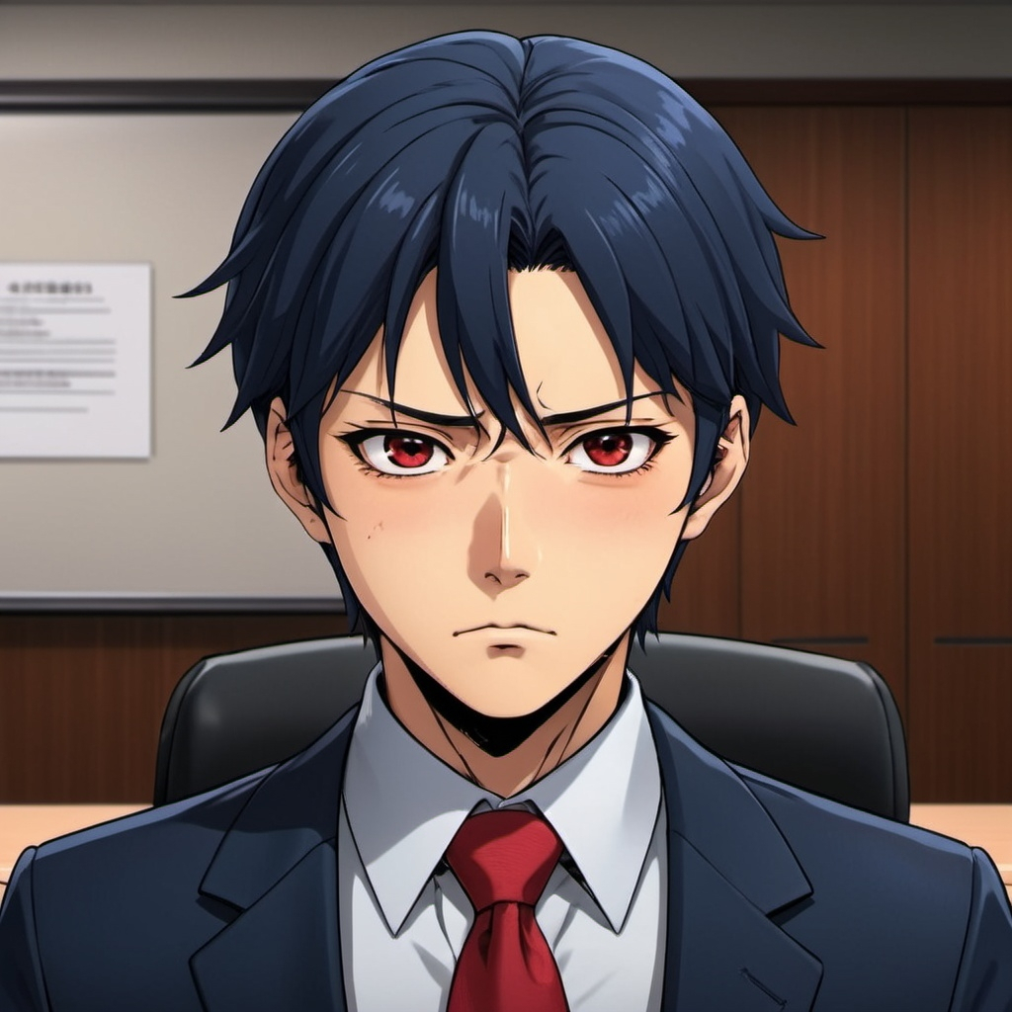
5. 意外
Notes:
The scene depicts Tanaka Seichi, a handsome Japanese-style office worker, standing at the front of a conference room. He has dark blue hair styled with a side-swept fringe and wears a formal suit with a red tie. In this moment, his expression shifts dramatically as he realizes that part of his presentation materials are missing, resulting in a blank slide. His eyes widen in shock, and his mouth slightly opens as a look of despair washes over his face. The background shows the conference room filled with colleagues, but all focus is on Seichi, capturing the weight of his disappointment and anxiety. His shoulders slump, and his body language conveys a deep sense of frustration and panic, reflecting the internal turmoil as he recalls the effort and anticipation he had leading up to this moment.

Slide 11
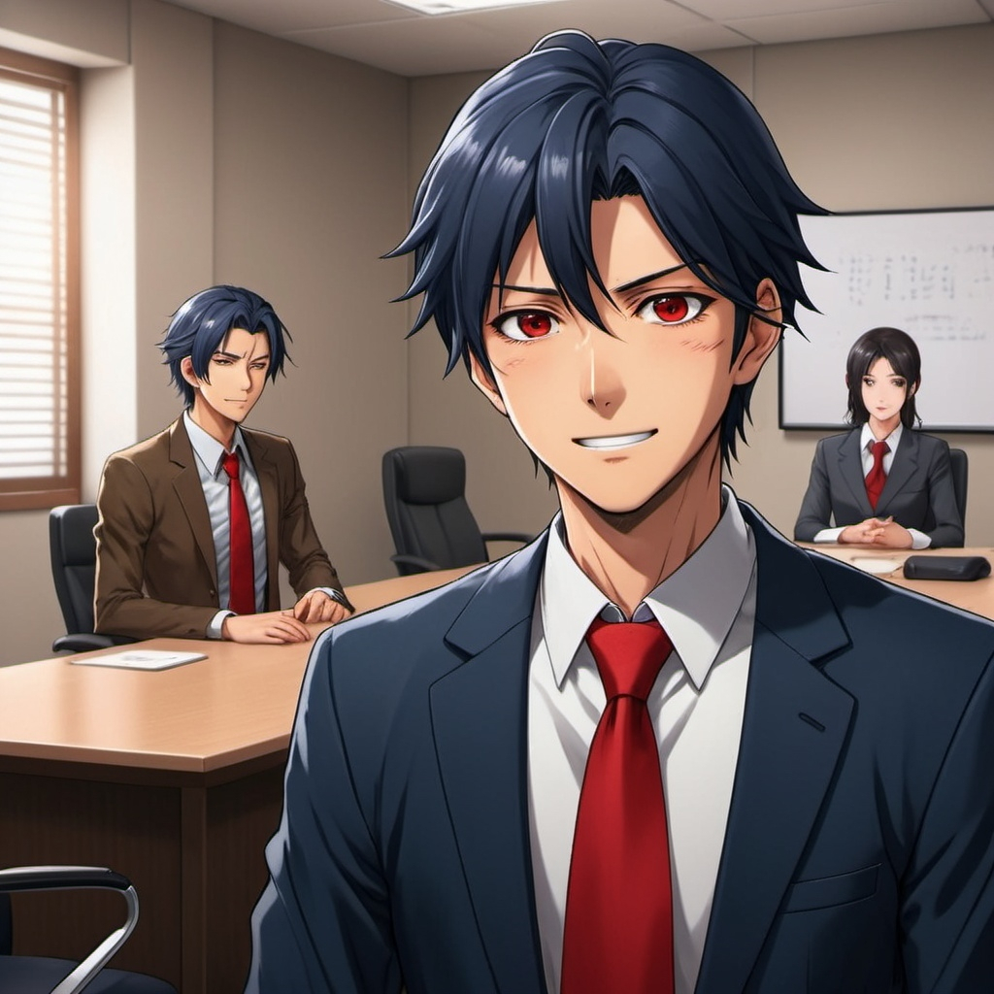
Notes:
The scene is set in a conference room where the atmosphere has shifted to a light and relaxed mood. The main character, Tanaka Seichi, a handsome Japanese-style office worker with dark blue hair and red eyes, stands at the front of the room. He is dressed in a suit with a red tie and appears visibly relieved and warmed by the supportive environment. In the foreground, several colleagues are laughing and smiling, their expressions conveying a sense of camaraderie and understanding. Some are leaning forward in their chairs, while others exchange amused glances, clearly enjoying the moment. In the background, the supervisor is nodding in agreement, further contributing to the positive atmosphere, as he says, "Sometimes, the most genuine stories are more persuasive than data." This statement resonates with Seichi, alleviating his earlier anxiety.

Slide 12
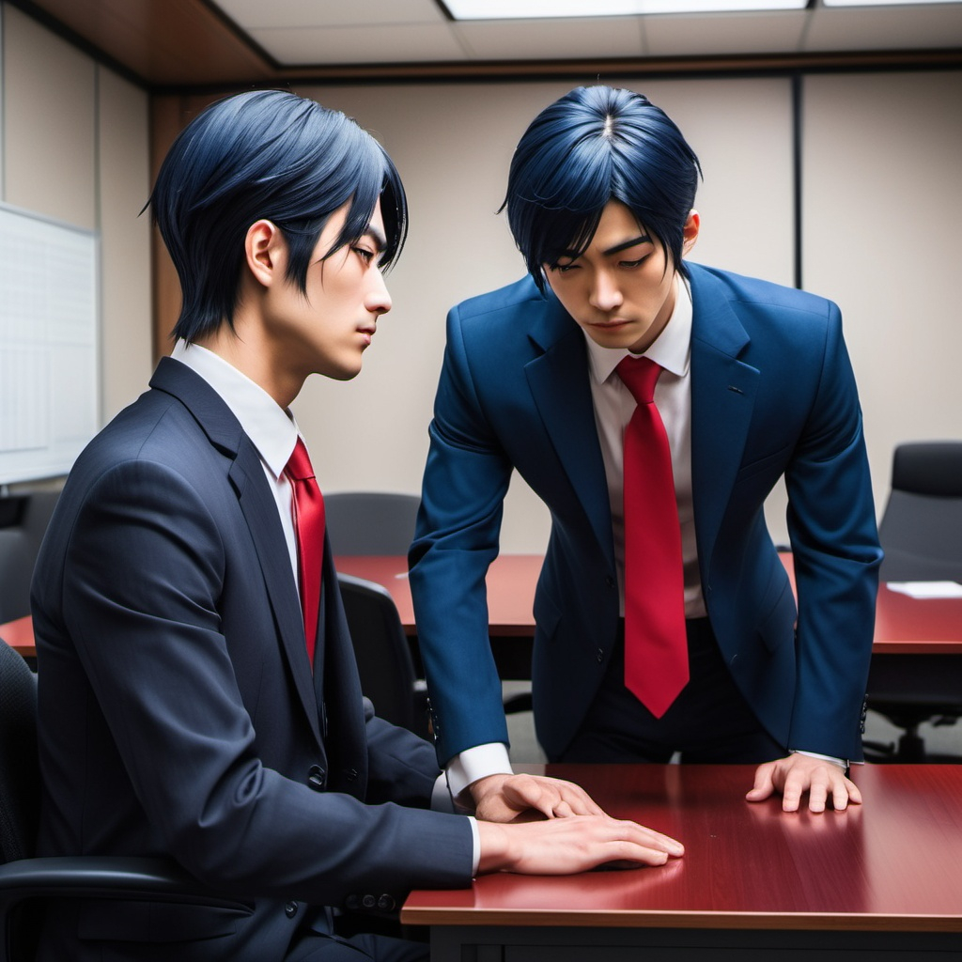
Notes:
A scene in a conference room where a handsome, Japanese-style office worker is bowing respectfully towards his supervisor. The character has dark blue hair styled in a side-swept fringe that extends past his eyebrows but stays above his eyes, and his eyes are red. He is wearing a formal suit with a striking red tie. The supervisor, sitting in the front row, is smiling and has an encouraging expression. The atmosphere is light and positive, with other colleagues in the background chuckling and enjoying the moment. The focus is on the main character’s respectful bowing gesture as he shares his experiences and insights from the day.

Slide 13
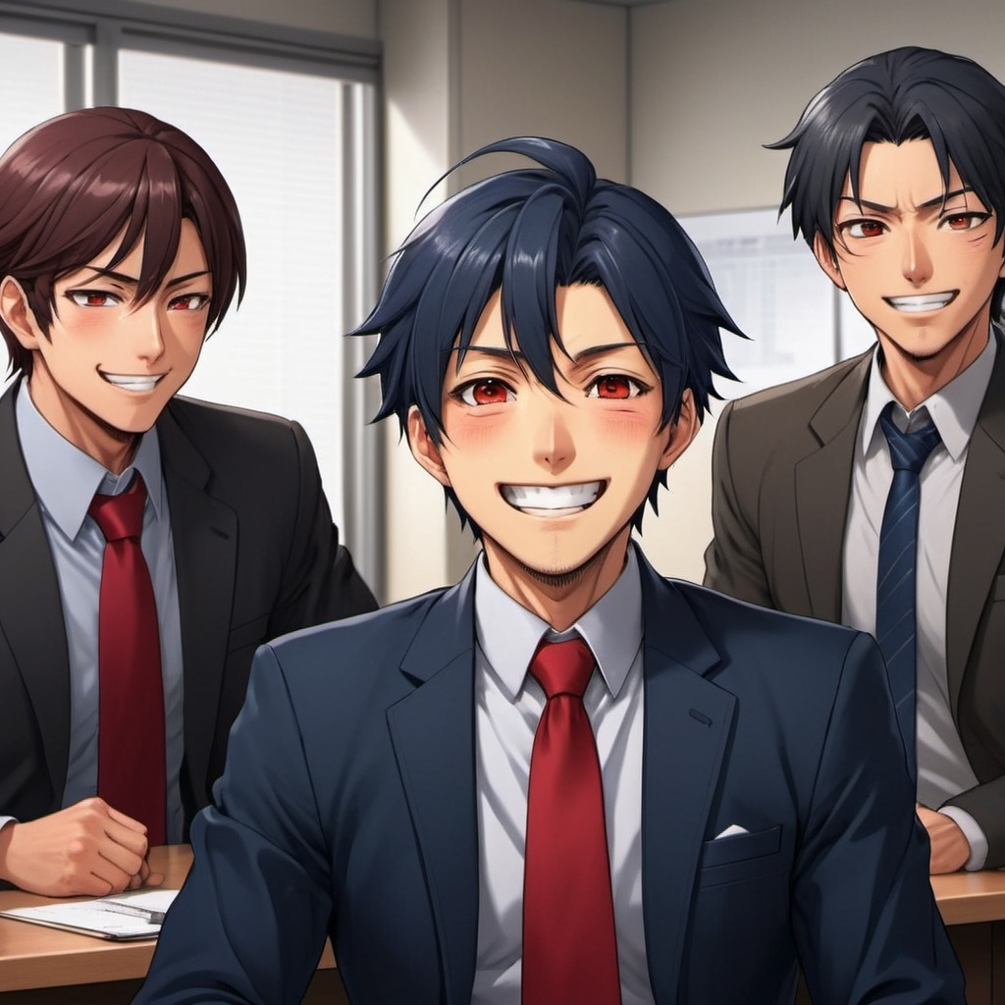
6.轉彎
Notes:
In a lively office setting, a group of colleagues is laughing and smiling, creating a warm and relaxed atmosphere. They are sitting at a conference table, with some leaning forward, clearly engaged in the moment. The main character, Tanaka Seichi, a handsome Japanese-style office worker with dark blue hair, red eyes, and a side-swept fringe, stands at the front with a relieved expression. He wears a formal suit and a red tie. The scene captures the lightheartedness and camaraderie in the room, emphasizing the shift in mood as laughter fills the air, making it evident that the tension has dissipated.

Slide 14
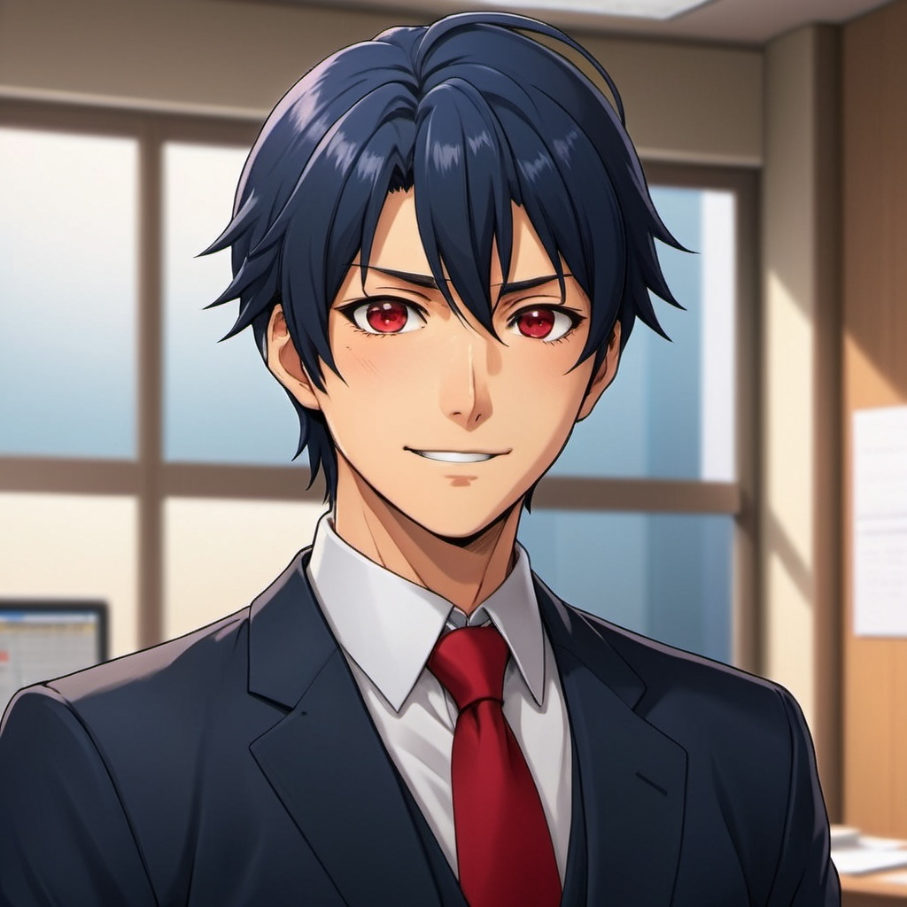
7. 結局
Notes:
In a bright and uplifting atmosphere, the main character, Tanaka Seichi, a handsome Japanese-style office worker with dark blue hair and red eyes, stands confidently with a radiant smile. He is dressed in a formal suit with a red tie, and his hair features a side-swept fringe. His expression is one of newfound clarity and joy, embodying the realization that challenges in work and life are opportunities for growth rather than obstacles. The background is filled with warm light, symbolizing hope and positivity, as he embraces this transformative mindset.

